Slide 1

Customer Shopping Behavior Analysis
A comprehensive analysis of 3,900 customer transactions — uncovering revenue patterns, segmentation insights, and actionable opportunities for data-driven growth.

Slide 2


Dataset Overview
About the Dataset
A rich transactional dataset covering the full customer journey — from demographics to post-purchase behavior.
3,900 Transactions
18 Features
Data Quality Note
Spanning 4 product categories with complete purchase records
Demographics, purchase details, shipping preferences, and behavioral signals
37 missing Review Rating values — imputed using per-category median to preserve integrity

Slide 3
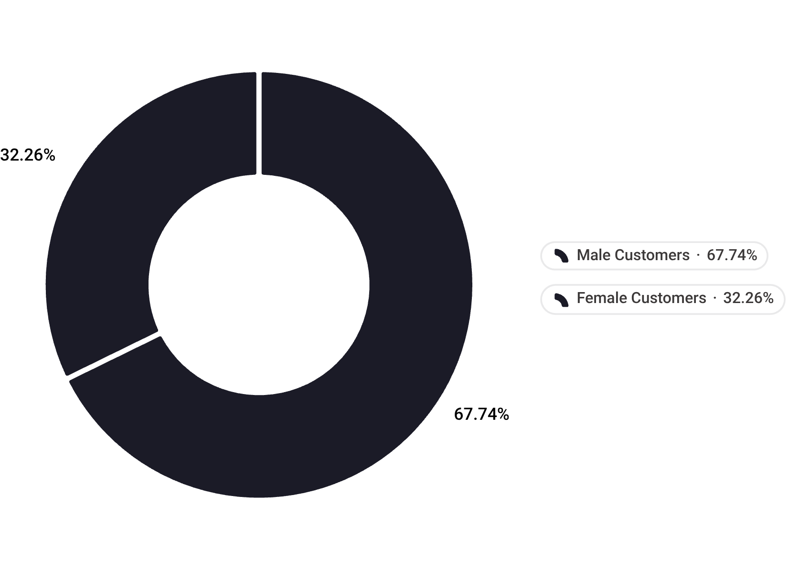
Revenue Distribution: Gender Gap
A Striking Imbalance
Male customers account for $157,890 — 67.7% of total revenue, while female customers contribute $75,191 (32.3%). This 2:1 ratio represents one of the most significant findings in the dataset.
The gap signals a significant opportunity to redesign engagement strategies targeting female customers — through personalization, targeted offers, or category expansion.
$157,890
$75,191
Male revenue share
Female revenue share

Slide 4


Subscription Impact on Revenue
2,847
1,053
Non-Subscribers
Subscribers
$170,436 revenue — 73.1% of total
$62,645 revenue — 26.9% of total
$0.38
Avg Spend Difference
$59.87 (non-sub) vs $59.49 (sub) — nearly identical
Key finding: Subscription status does not drive higher per-transaction spend. The program's value proposition may need to be re-evaluated — it is not currently differentiating customer behavior.

Slide 5
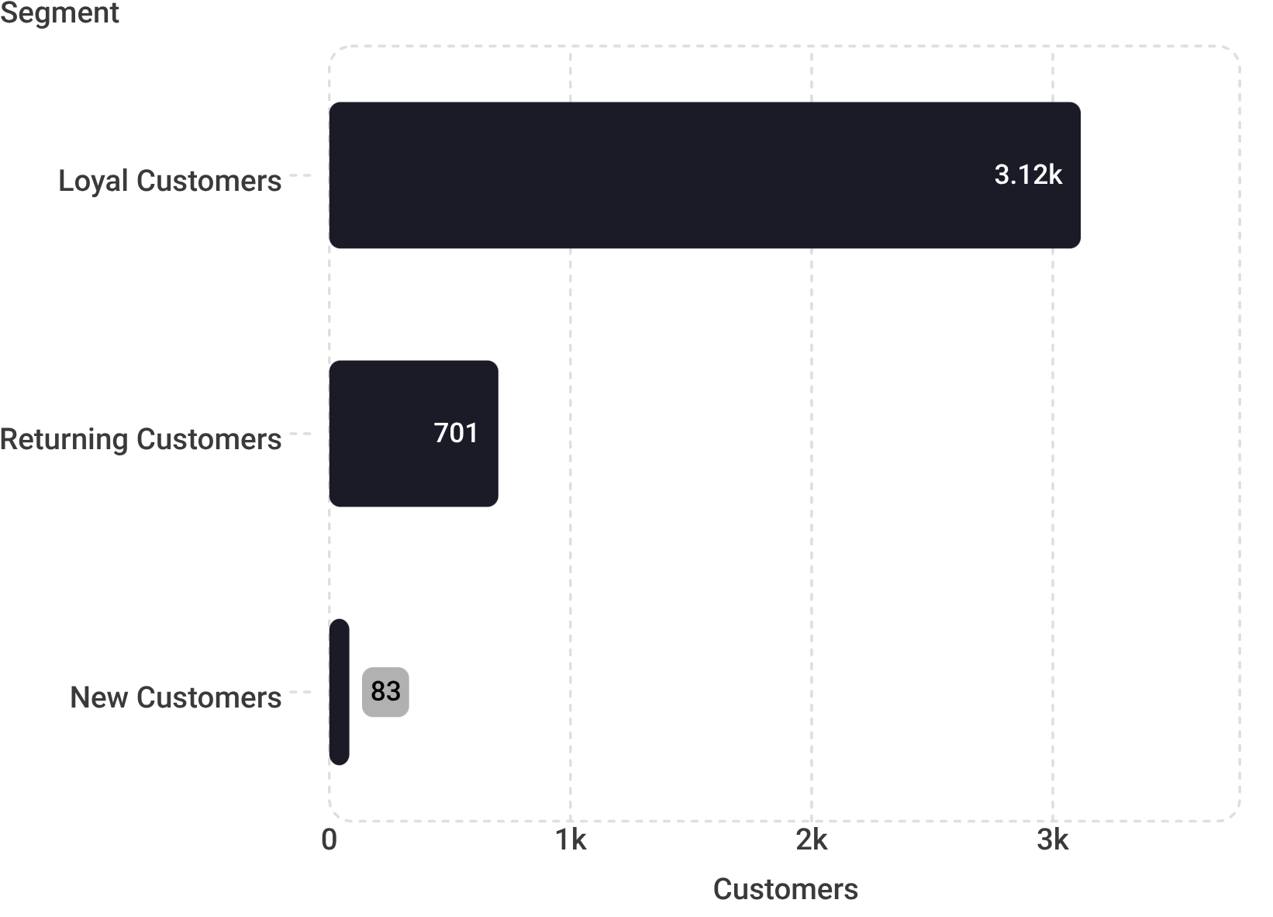
Customer Segmentation Breakdown
Segment Profiles
Loyal — 79.9% (3,116 customers)
Repeat purchasers with strong engagement signals. The backbone of current revenue.
Returning — 18.0% (701 customers)
Moderate purchase history. A conversion target to move into the loyal tier.
New — 2.1% (83 customers)
Critically low new acquisition rate. Indicates a significant pipeline risk for long-term growth.

Slide 6





Top-Performing Products by Rating
🥇 Gloves — 3.86
🥈 Sandals — 3.84
🥉 Boots — 3.82
Hat — 3.80
Highest-rated product in the catalog
Strong seasonal performer with high satisfaction
Consistent quality perception across reviewers
Also leads discount dependency analysis at 50%
Skirt — 3.78
Rounds out the top 5; above category average
Overall average review rating across all products: 3.75 / 5.0

Slide 7
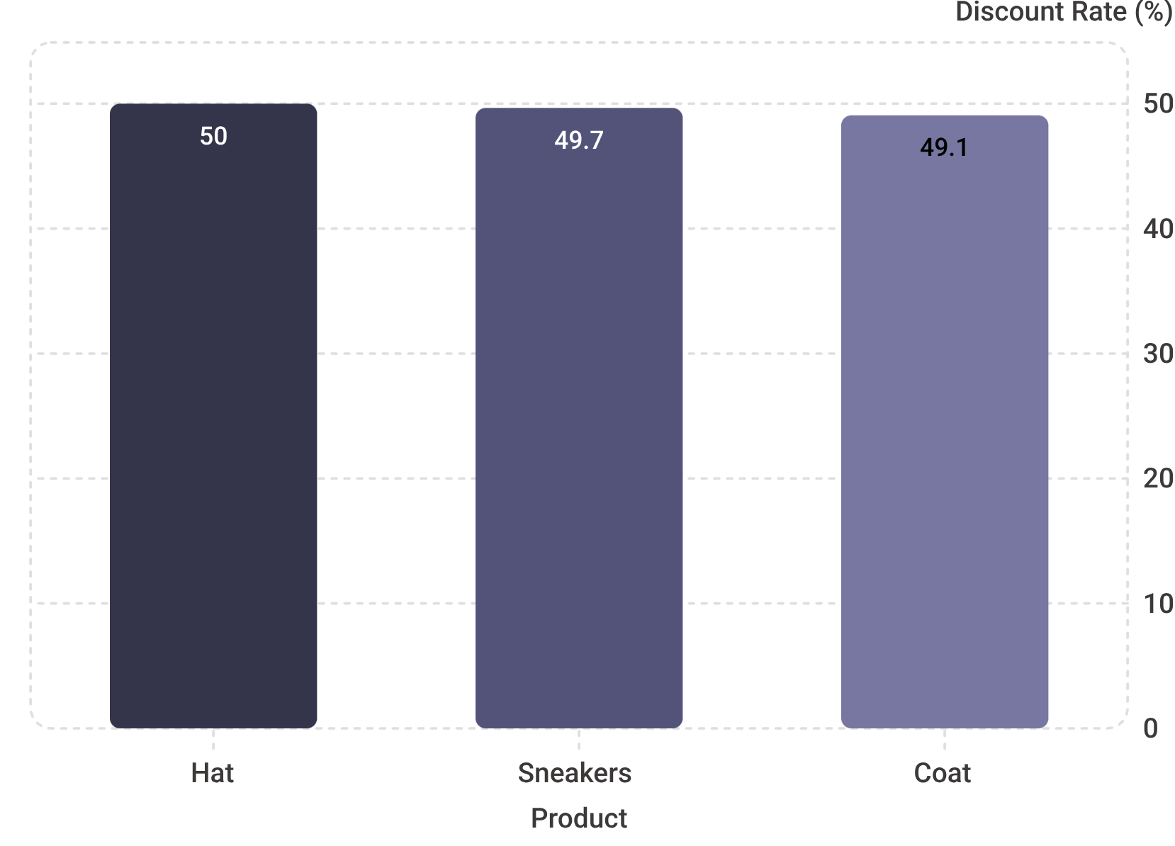


Discount Dependency Analysis
A Discount-Heavy Ecosystem
57% of all purchases (2,223 out of 3,900) involved a discount — a rate that raises serious margin sustainability concerns.
Heavy reliance on discounts across 57% of transactions risks training customers to wait for promotions — directly compressing long-term margins.
Hat — 50%
Sneakers — 49.66%
Coat — 49.07%
Highest discount dependency in catalog; top-rated product yet most discounted
Near-universal discounting in this high-volume category
Seasonal heavy discounting compressing potential margins

Slide 8

High-Spending Discount Users
A counterintuitive segment emerges from the data: customers who used discounts but still spent above average.
839 Customers
21.5% of Transactions
Used a discount AND spent above the $59.76 average threshold
Represents more than 1 in 5 purchases across the entire dataset
Price-Insensitive Signal
These customers spend high even with discounts — they likely do not need the discount to convert
Strategic opportunity: Identify and suppress discount delivery for this segment to protect revenue per transaction. Their behavior indicates discount removal will not reduce purchase likelihood.

Slide 9
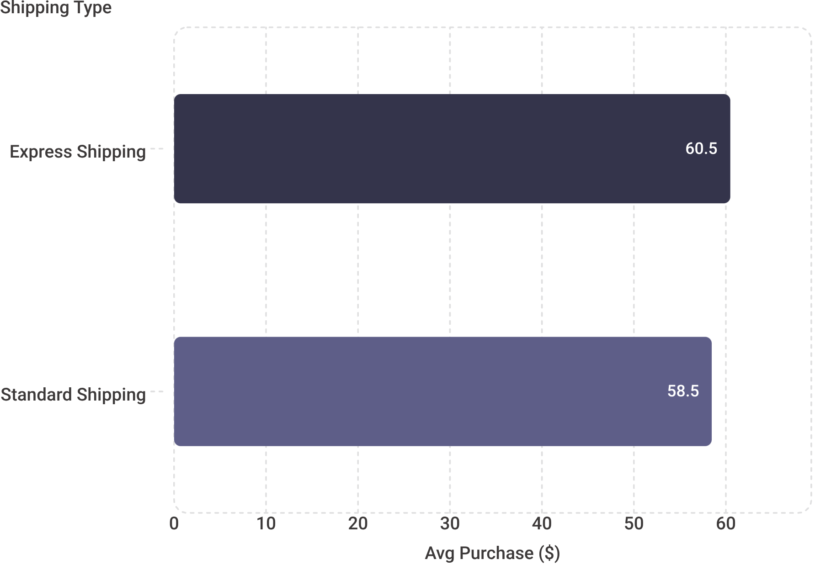
Shipping Type & Purchase Amount
Speed Signals Spending Power
Express shipping users spend 3.5% more per transaction on average — a small but statistically meaningful gap that reveals a willingness-to-pay premium.
Express avg: $60.48 per transaction
Standard avg: $58.46 per transaction
$2.02 gap per order across thousands of transactions compounds significantly
Consider bundling express shipping with higher-margin products or premium tiers to capture this spend propensity.

Slide 10
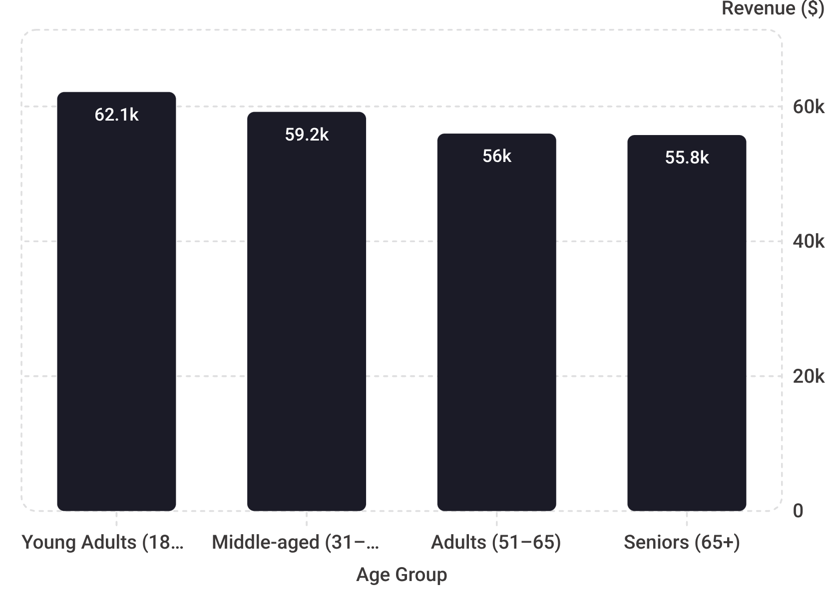


Revenue by Age Group
Relatively Balanced Age Distribution
Revenue is surprisingly even across age groups — no single cohort dominates, suggesting broad product-market fit.
The narrow $6,380 spread across all age groups suggests age alone is not a strong revenue predictor — behavioral segmentation (loyalty tier, shipping preference) may be more actionable.
Young Adults — $62,143 (26.6%)
Middle-aged — $59,197 (25.4%)
Adults & Seniors — $55,978 / $55,763
Top revenue cohort — high engagement, likely influenced by trends and digital channels
Strong and consistent; likely the most reliable repeat-purchase segment
Marginally lower but within 12% of the top cohort — an underserved opportunity

